Slide 1
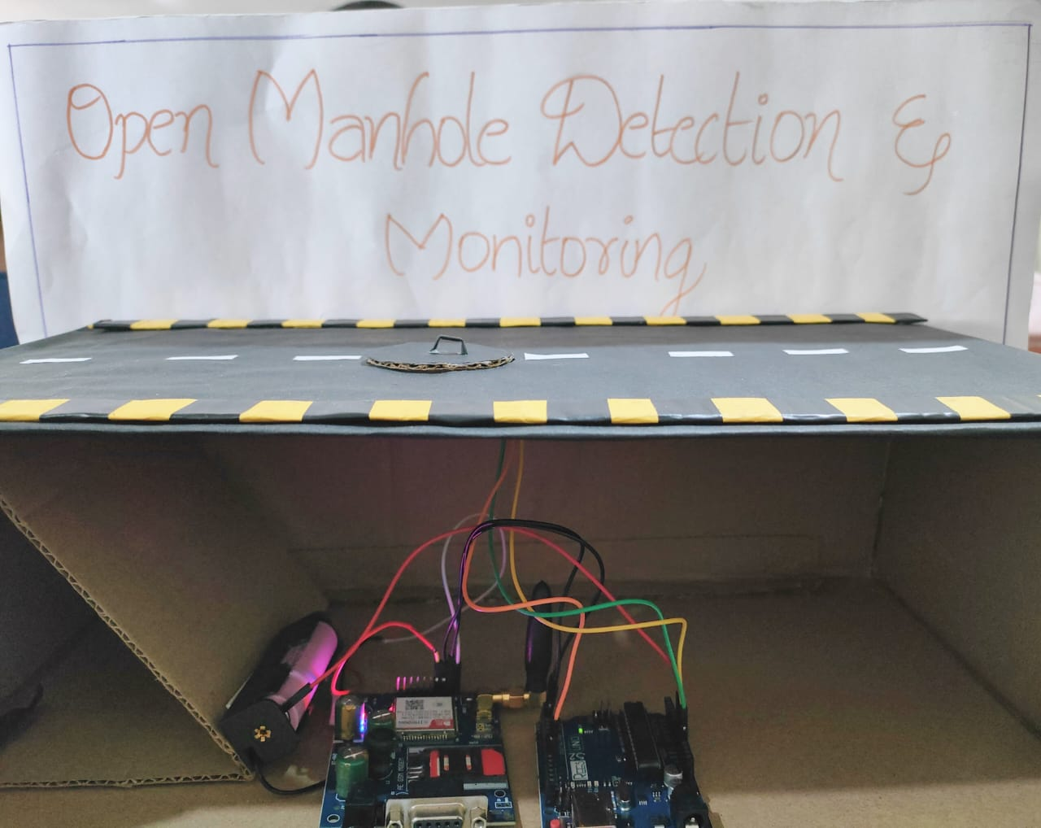
OPEN MANHOLE DETECTION AND MONITORING
M. Vasanth Reddy

Slide 2
PROBLEM STATEMENT :
Today's drainage system is not high-tech. So whenever there is blockage it is difficult to figure out the exact location of the blockage. Also, early alerts of the blockage are not received. Hence detection and repairing of the blockage become time consuming. It becomes very inconvenient to handle the situation when pipes are blocked completely. Due to such failure of drainage line people face a lot of problems.
SOLUTION :
• Detect the location.
• The system governing the flow of sewage from pipes.
• Use of flow sensors to detect the variations in the flow.
• Get the prior alerts of blockages and locate them using IOT.
• Trace location using GPS and send SMS through GSM.

Slide 3
OBJECTIVES :
• Cleaner cities and intelligent management of drainage in the city.
• Detection of drainage water level and blockages in the drainage.
• Checking water flow rate continuously, as well as sending automatic mail, display on the monitor if the water level is outside of an expected normal range.
• The main objective is to obtain an effective low-cost and flexible solution for condition monitoring and infrastructure management in the city.
• Detecting gas and updating it in real time through IoT.

Slide 4
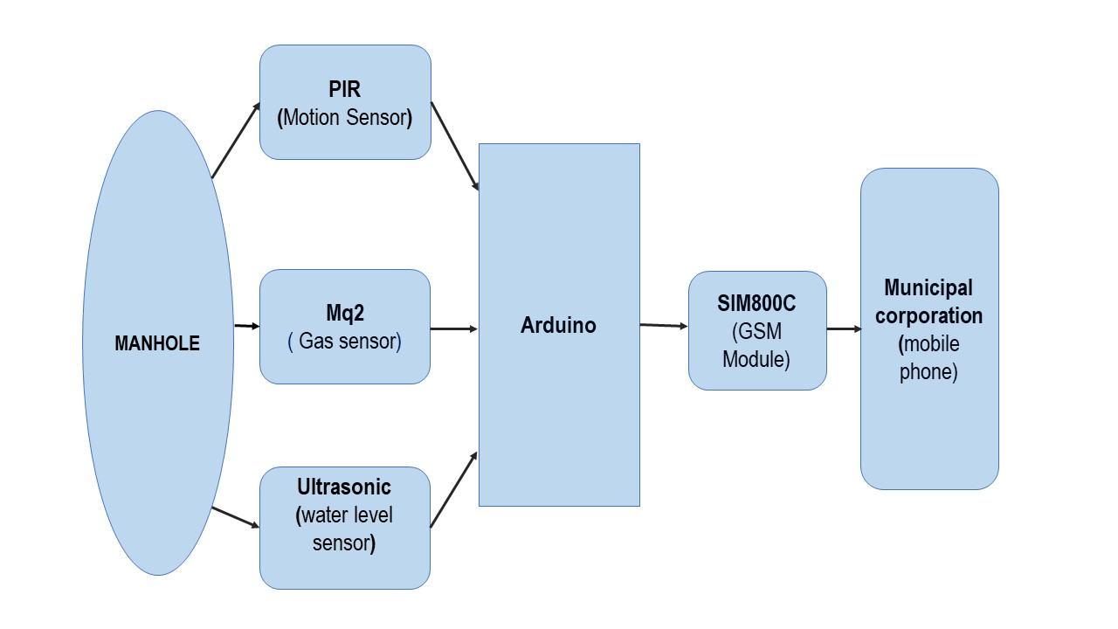
BLOCK DIAGRAM :

Slide 5
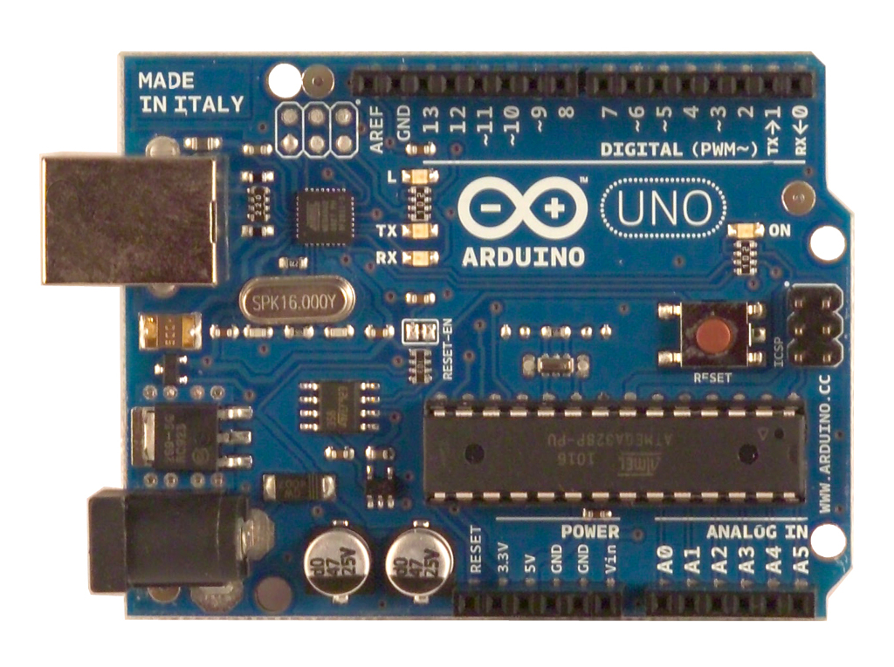
CIRCUIT COMPONENTS :
Arduino Uno

Slide 6
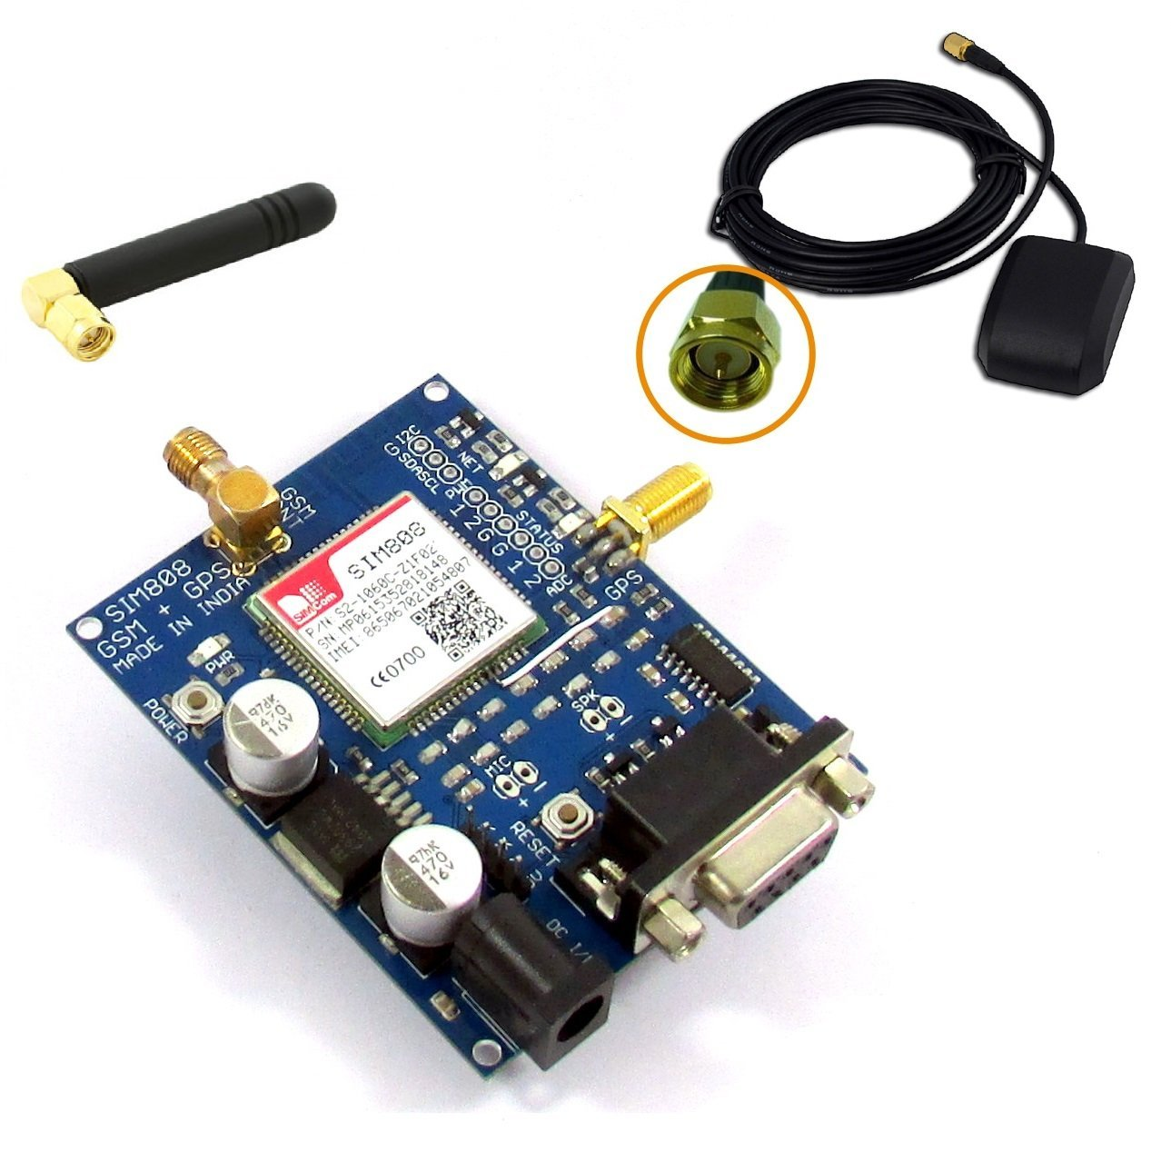
GSM Module

Slide 7
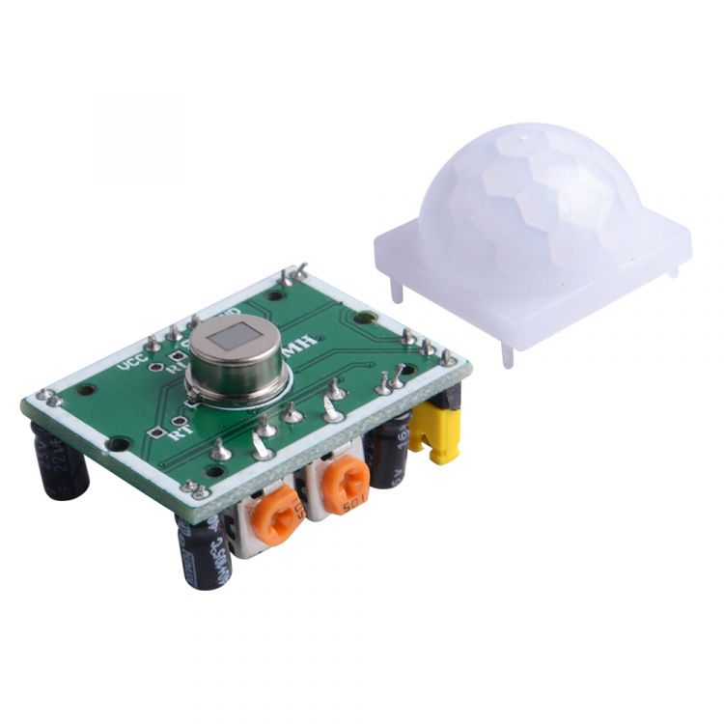
PIR Sensor

Slide 8
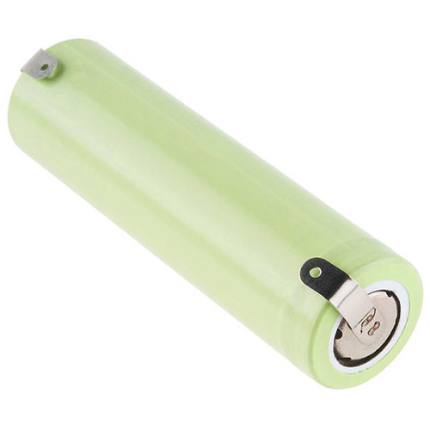
18650 Cell ( Battery )

Slide 9
PROTOTYPE :

Slide 10
CONCLUSION :
Underground monitoring is challenging problem. This project proposes different methods for monitoring and managing underground drainage system. It explains various applications like underground drainage and manhole identification in real time. Various parameters like temperature, toxic gases, level of water are being monitored and updated using the Internet of Things. This enables the person in-charge to take the necessary actions regarding the same. In this way the unnecessary trips on the manholes are saved and can only be conducted when required. Also, real time update on the internet helps in maintaining the regularity in drainage check thus avoid the hazards.

Slide 11
THANK YOU

